Slide 1

JS

Slide 2
Focus points:
Arrays
Loops
Document Object Model
Events

Slide 3
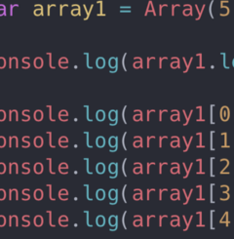
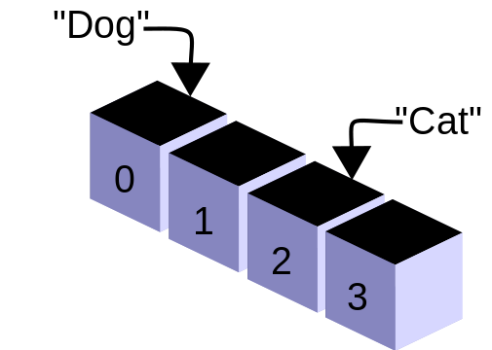
Array
JAVASCRIPT

Slide 4
Array
The Array object, as with arrays in other programming languages, enables storing a collection of multiple items under a single variable name, and has members for performing common array operations.
In JavaScript, arrays aren't primitives but are instead Array objects with the following core characteristics:
JavaScript arrays are resizable and can contain a mix of different data types. (When those characteristics are undesirable, use typed arrays instead.)
JavaScript arrays are not associative arrays and so, array elements cannot be accessed using strings as indexes, but must be accessed using integers as indexes.
JavaScript arrays are zero-indexed - meaning the first element of an array is at index 0, the second is at index 1, and so on — and the last element is at the value of the array's length property minus 1.
JavaScript array-copy operations create shallow copies. (All standard built-in copy operations with any JavaScript objects create shallow copies, rather than deep copies).

Slide 5
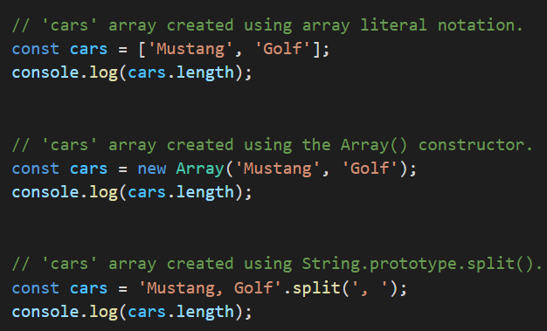
How to create an array
This example shows three ways to create new array: first using array literal notation, then using the Array() constructor, and finally using String.prototype.split() to build the array from a string.

Slide 6
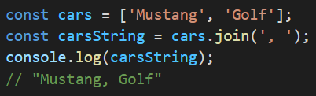
Create a string from an array
This example uses the join() method to create a string from the cars array. The join() method creates and returns a new string by concatenating all of the elements in an array (or an array-like object), separated by commas or a specified separator string. If the array has only one item, then that item will be returned without using the separator.

Slide 7
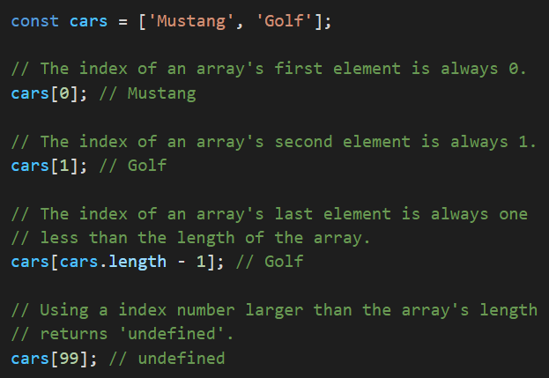
Access an array item
This example shows how to access items in the cars array by specifying the index number of their position in the array.

Slide 8
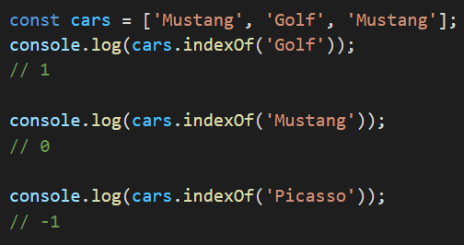
Find the index of an item in an array
This example uses the indexOf() method to find the position (index) of the string “Golf" in the cars array. The indexOf() method returns the first index at which a given element can be found in the array, or -1 if it is not present.

Slide 9
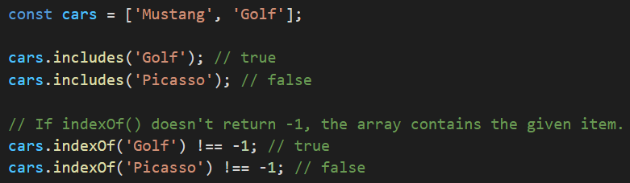
Check if an array contains a certain item
This example shows two ways to check if the cars array contains “Golf" and “Picasso": first with the includes() method, and then with the indexOf() method to test for an index value that's not -1. The includes() method determines whether an array includes a certain value among its entries, returning true or false as appropriate.

Slide 10
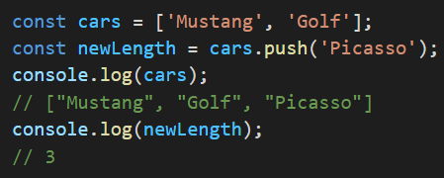
Append an item to an array
This example uses the push() method to append a new string to the cars array. The push() method adds one or more elements to the end of an array and returns the new length of the array.

Slide 11
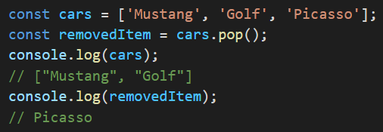
Remove the last item from an array
This example uses the pop() method to remove the last item from the cars array. The pop() method removes the last element from an array and returns that element. This method changes the length of the array.

Slide 12
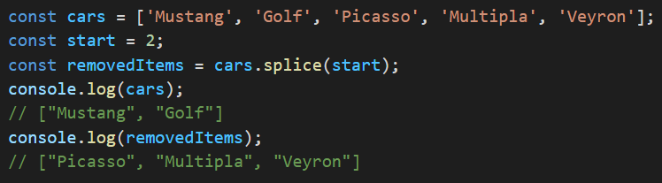
Truncate an array down to just its first N items
This example uses the splice() method to truncate the cars array down to just its first 2 items. The splice() method changes the contents of an array by removing or replacing existing elements and/or adding new elements in place.

Slide 13
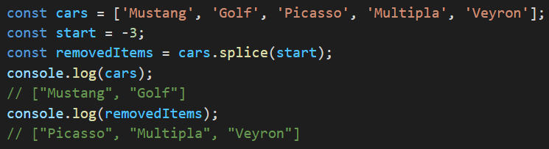
Remove multiple items from the end of an array
This example uses the splice() method to remove the last 3 items from the cars array. If parameter is negative, it will remove that many elements from the end of the array.

Slide 14
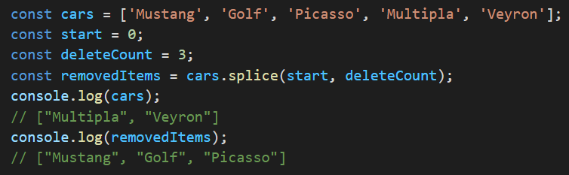
Remove multiple items from the beginning of an array
This example uses the splice() method to remove the first 3 items from the cars array.

Slide 15
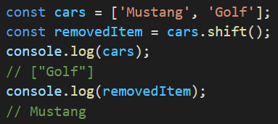
Remove the first item from an array
This example uses the shift() method to remove the first item from the cars array. The shift() method removes the first element from an array and returns that removed element. This method changes the length of the array.

Slide 16
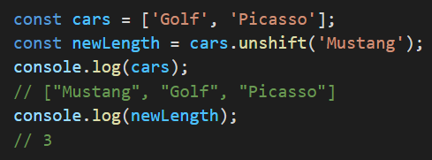
Add a new first item to an array
This example uses the unshift() method to add, at index 0, a new item to the cars array — making it the new first item in the array. The unshift() method adds one or more elements to the beginning of an array and returns the new length of the array.

Slide 17
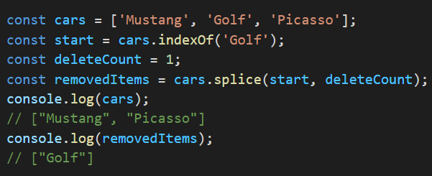
Remove a single item by index
This example uses the splice() method to remove the string “Golf" from the cars array — by specifying the index position of “Golf".

Slide 18
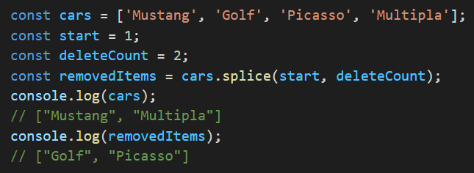
Remove multiple items by index
This example uses the splice() method to remove the strings “Golf" and “Picasso" from the cars array — by specifying the index position of “Golf", along with a count of the number of total items to remove.

Slide 19
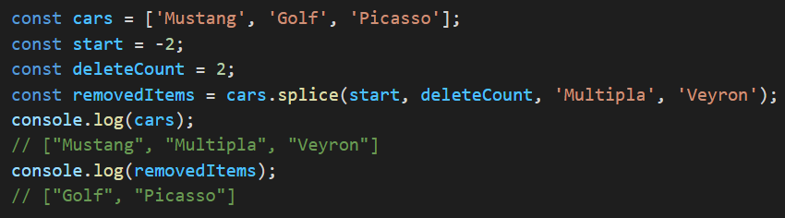
Replace multiple items in an array
This example uses the splice() method to replace the last 2 items in the cars array with new items.

Slide 20
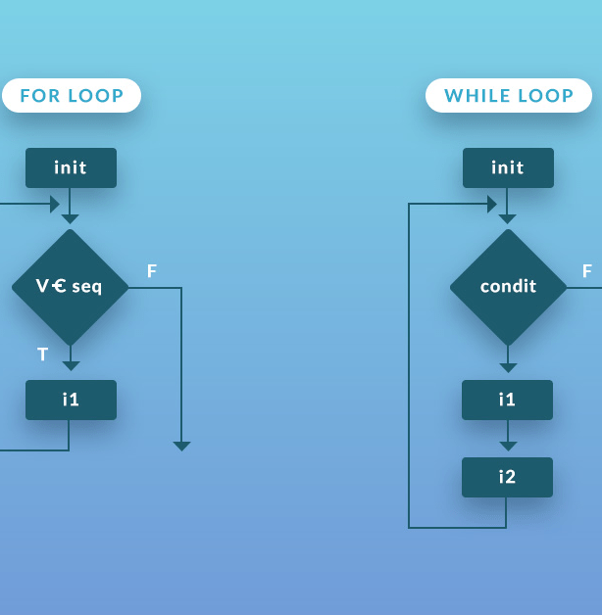
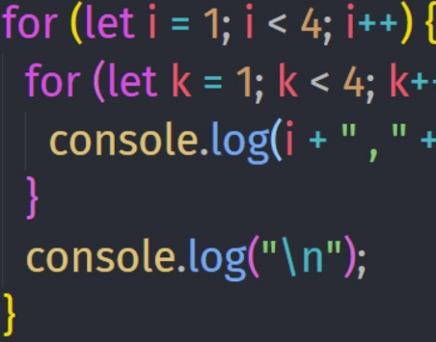
Loops
JAVASCRIPT

Slide 21
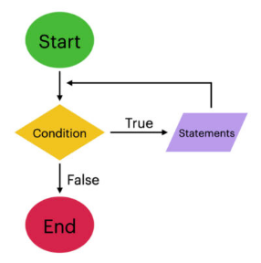
Loops
In computer programming, a loop is a sequence of instructions that is continually repeated until a certain condition is reached. Typically, a certain process is done, such as getting an item of data and changing it, and then some condition is checked such as whether a counter has reached a prescribed number. In one sentence, loops are a way to repeat the same code multiple times.

Slide 22
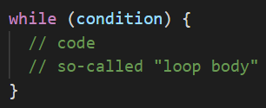
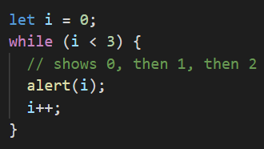
While
The while loop has the following syntax:
While the condition is truthy, the code from the loop body is executed.
For instance, the loop below outputs i while i < 3:
A single execution of the loop body is called an iteration. The loop in the example makes three iterations.
If i++ was missing from the example, the loop would repeat (in theory) forever.

Slide 23
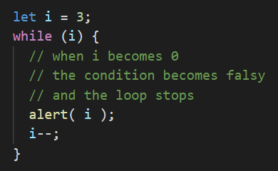

While
Any expression or variable can be a loop condition, not just comparisons: the condition is evaluated and converted to a boolean by while. For instance, a shorter way to write while (i != 0) is while (i):
Note: If the loop body has a single statement, we can omit the curly braces {…}

Slide 24
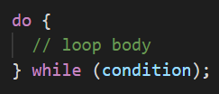
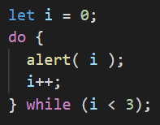
Do while
The do while loop has the following syntax:
The loop will first execute the body, then check the condition, and, while it’s truthy, execute it again and again. This form of syntax should only be used when you want the body of the loop to execute at least once regardless of the condition being truthy.

Slide 25


For loop
The for loop is more complex, but it’s also the most commonly used loop. Here’s its syntax:
Let’s learn the meaning of these parts by example. The loop below runs alert(i) for i from 0 up to (but not including) 3:

Slide 26
For loop
The general loop algorithm works like this:
begin | Executes once upon entering the loop
condition | Checked before every loop iteration. If false, the loop stops.
body | Runs again and again while the condition is truthy.
step | Executes after the body on each iteration.
Run begin
(if condition → run body and run step)
(if condition → run body and run step)
(if condition → run body and run step)
...
That is, begin executes once, and then it iterates: after each condition test, body and step are executed.

Slide 27
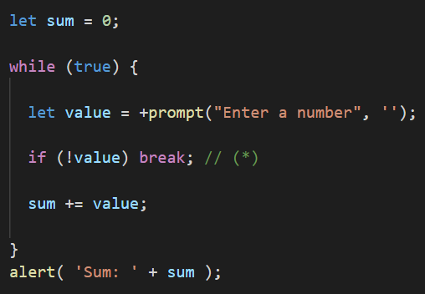
Breaking the loop
Normally, a loop exits when its condition becomes falsy. But we can force the exit at any time using the special break directive. For example, the loop below asks the user for a series of numbers, “breaking” when no number is entered:
The break directive is activated at the commented line (*) if the user enters an empty line or cancels the input. It stops the loop immediately, passing control to the first line after the loop. Namely, alert.
The combination “infinite loop + break as needed” is great for situations when a loop’s condition must be checked not in the beginning or end of the loop, but in the middle or even in several places of its body.

Slide 28
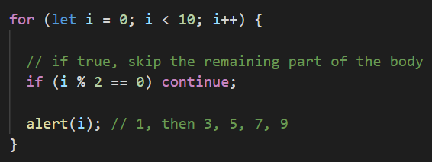
Continue to next iteration
The continue directive is a “lighter version” of break. It doesn’t stop the whole loop. Instead, it stops the current iteration and forces the loop to start a new one (if the condition allows). We can use it if we’re done with the current iteration and would like to move on to the next one. The loop below uses continue to output only odd values:
For even values of i, the continue directive stops executing the body and passes control to the next iteration of for (with the next number). So the alert is only called for odd values.

Slide 29
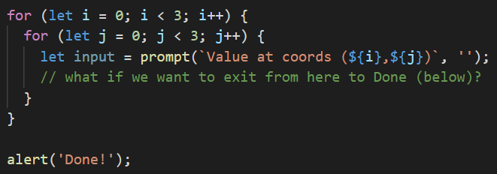
Labels for break/continue
Sometimes we need to break out from multiple nested loops at once. For example, in the code below we loop over i and j, prompting for the coordinates (i, j) from (0,0) to (2,2):
We need a way to stop the process if the user cancels the input. The ordinary break after input would only break the inner loop. That’s not sufficient – labels, come to the rescue!

Slide 30

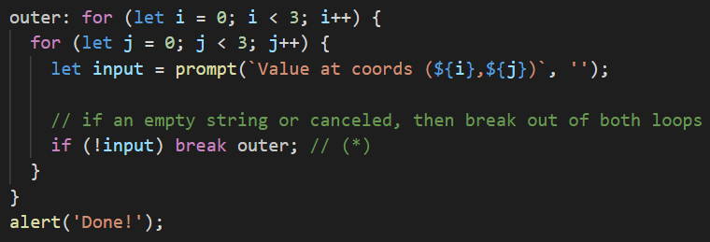
Labels for break/continue
A label is an identifier with a colon before a loop:
The break <labelName> statement in the loop below breaks out to the label:

Slide 31
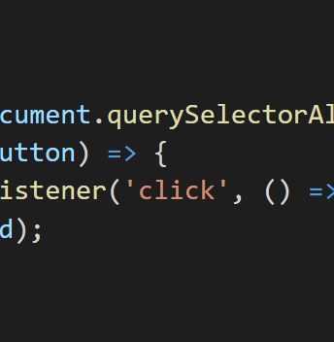
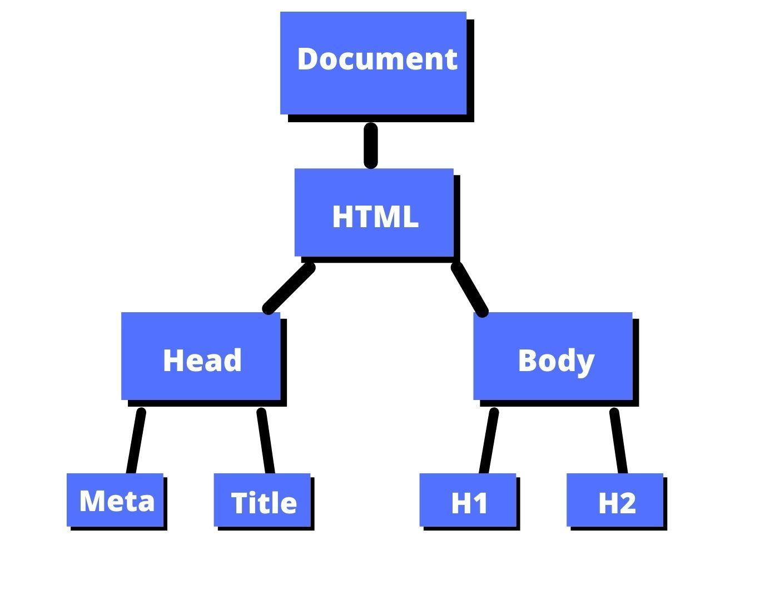
DOM
JAVASCRIPT

Slide 32
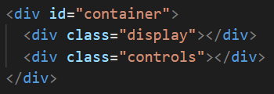
DOM - Document Object Model
The DOM (or Document Object Model) is a tree-like representation of the contents of a webpage - a tree of “nodes” with different relationships depending on how they’re arranged in the HTML document.
In the above example, the <div class="display"></div> is a “child” of <div id="container"></div> and a sibling to <div class="controls"></div>. Think of it like a family tree. <div id="container"></div> is a parent, with its children on the next level, each on their own “branch”.

Slide 33
DOM - Document Object Model
When working with the DOM, you use “selectors” to target the nodes you want to work with. You can use a combination of CSS-style selectors and relationship properties to target the nodes you want. Let’s start with CSS-style selectors. In the example, you could use the following selectors to refer to <div class="display"></div>:
div.display
.display
#container > .display
div#container > div.display

Slide 34
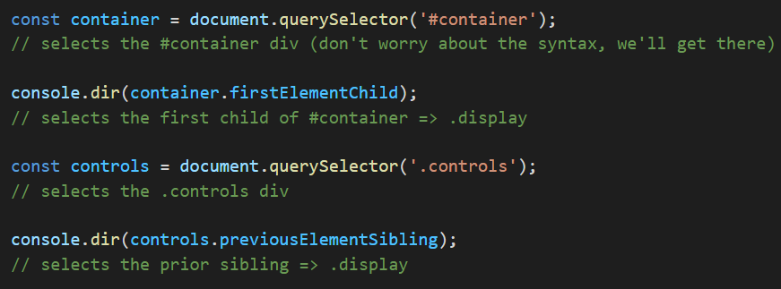
DOM - Document Object Model
You can also use relational selectors (i.e. firstElementChild or lastElementChild etc.) with special properties owned by the nodes. So you’re identifying a certain node based on its relationships to the nodes around it.

Slide 35
DOM methods
When your HTML code is parsed by a web browser, it is converted to the DOM as was mentioned above. One of the primary differences is that these nodes are objects that have many properties and methods attached to them. These properties and methods are the primary tools we are going to use to manipulate our webpage with JavaScript. We’ll start with the query selectors - those that help you target nodes.
Query Selectors:
element.querySelector(selector) returns a reference to the first match of selector
element.querySelectorAll(selectors) returns a “nodelist” containing references to all of the matches of the selectors
*There are several other, more specific queries, that offer potential (marginal) performance benefits, but we won’t be going over them now.
Note: when using querySelectorAll, the return value is not an array. It looks like an array, and it somewhat acts like an array, but it’s really a “nodelist”. The big distinction is that several array methods are missing from nodelists. One solution, if problems arise, is to convert the nodelist into an array. You can do this with Array.from() or the spread operator.

Slide 36
Element creation
document.createElement(tagName, [options]) creates a new element of tag type tagName. [options] in this case means you can add some optional parameters to the function. This function does NOT put your new element into the DOM - it simply creates it in memory. This is so that you can manipulate the element (by adding styles, classes, ids, text, etc.) before placing it on the page.
Query Selectors:
element.querySelector(selector) returns a reference to the first match of selector
element.querySelectorAll(selectors) returns a “nodelist” containing references to all of the matches of the selectors
*There are several other, more specific queries, that offer potential (marginal) performance benefits, but we won’t be going over them now.
Note: when using querySelectorAll, the return value is not an array. It looks like an array, and it somewhat acts like an array, but it’s really a “nodelist”. The big distinction is that several array methods are missing from nodelists. One solution, if problems arise, is to convert the nodelist into an array. You can do this with Array.from() or the spread operator.

Slide 37
Element creation
You can place the element into the DOM with one of the following methods:
parentNode.appendChild(childNode) appends childNode as the last child of parentNode
parentNode.insertBefore(newNode, referenceNode) inserts newNode into parentNode before referenceNode
You can remove the element from the DOM with the following method:
parentNode.removeChild(child) removes child from parentNode on the DOM and returns a reference to child

Slide 38

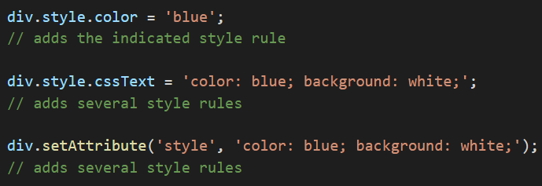
Altering elements
When you have a reference to an element, you can use that reference to alter the element’s own properties. This allows you to do many useful alterations, like adding/removing and altering attributes, changing classes, adding inline style information and more.
How to add inline style:

Slide 39
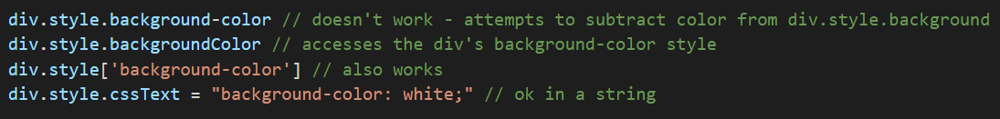
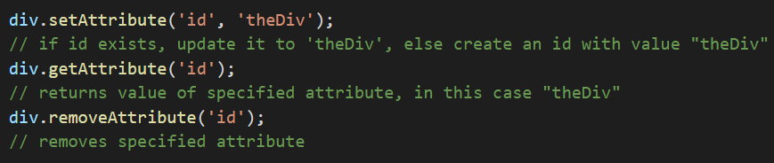
Altering elements
Note that if you’re accessing a kebab-cased CSS rule from JS, you’ll either need to use camelCase or you’ll need to use bracket notation instead of dot notation.
How to edit attributes:

Slide 40
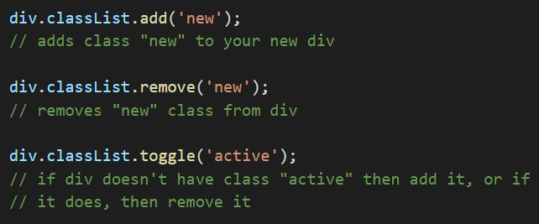
Working with classes
It is often standard (and cleaner) to toggle a CSS style rather than adding and removing inline CSS.

Slide 41
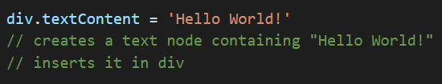

Adding text and html content
Here’s how you would add text content:
Here’s how you would add HTML content:
Note: that textContent is preferable for adding text, and innerHTML should be used sparingly as it can create security risks if misused. Check out this video if you want to see an example of how.

Slide 42
Exercise
Add the following elements to the container using ONLY JavaScript and the DOM methods shown previously.
a <p> with red text that says, “Hey I’m red!”
an <h3> with blue text that says, “I’m a blue h3!”
a <div> with a black border and pink background color with the following elements inside of it:
another <h1> that says “I’m in a div”
a <p> that says, “ME TOO!”
Hint for this one: after creating the <div> with createElement, append the <h1> and <p> to it before adding it to the container.

Slide 43
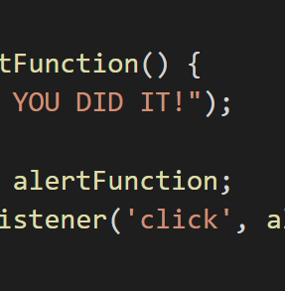
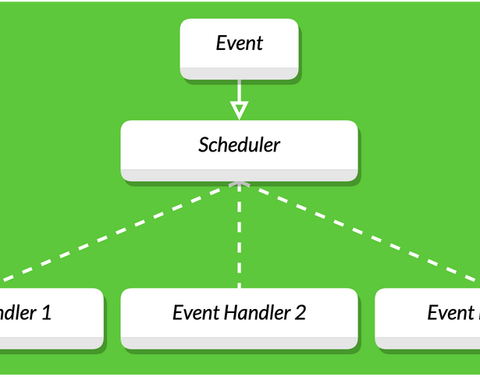
Events
JAVASCRIPT

Slide 44

Events
Events are actions or occurrences that happen in the system you are programming, which the system tells you about so your code can react to them.
As mentioned above, events are actions or occurrences that happen in the system you are programming — the system produces (or "fires") a signal of some kind when an event occurs and provides a mechanism by which an action can be automatically taken (that is, some code running) when the event occurs. For example, in an airport, when the runway is clear for take off, a signal is communicated to the pilot. As a result, the plane can safely take off.

Slide 45
Events
In the case of the Web, events are fired inside the browser window, and tend to be attached to a specific item that resides in it. This might be a single element, a set of elements, the HTML document loaded in the current tab, or the entire browser window. There are many different types of events that can occur.
For example:
The user selects, clicks, or hovers the cursor over a certain element.
The user chooses a key on the keyboard.
The user resizes or closes the browser window.
A web page finishes loading.
A form is submitted.
A video is played, paused, or finishes.
An error occurs.
There are a lot of events that can be fired.

Slide 46
Event Handler
To react to an event, you attach an event handler to it. This is a block of code (usually a JavaScript function that you as a programmer create) that runs when the event fires. When such a block of code is defined to run in response to an event, we say we are registering an event handler.
Note: Event handlers are sometimes called event listeners — they are pretty much interchangeable for our purposes, although strictly speaking, they work together. The listener listens out for the event happening, and the handler is the code that is run in response to it happening.
Note: Web events are not part of the core JavaScript language — they are defined as part of the APIs built into the browser.

Slide 47

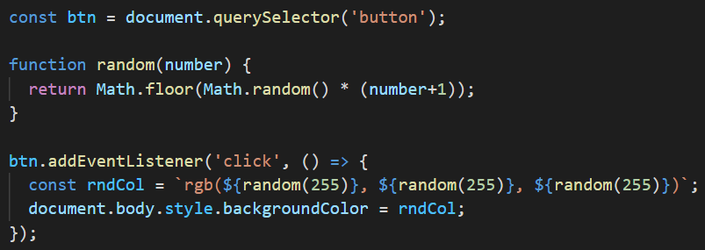
Event Handler
Let's look at a simple example of what we mean here. In the following example, we have a single <button>, which when pressed, makes the background change to a random color:

Slide 48
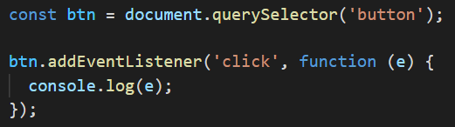
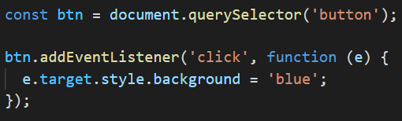
Event Handler
We can access more information about the event by passing a parameter to the function that we are calling. For example:
The e in that function is an object that references the event itself. Within that object you have access to many useful properties and functions such as which mouse button or key was pressed, or information about the event’s target - the DOM node that was clicked.

Slide 49
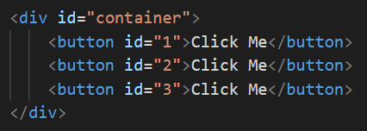
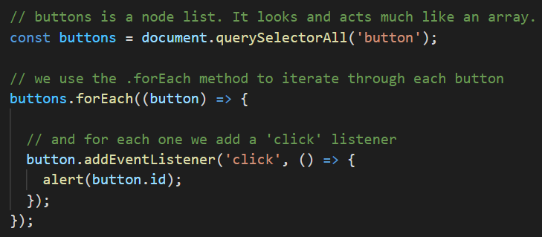
Attaching listeners to groups of nodes
We can get a nodelist of all of the items matching a specific selector with querySelectorAll('selector'). In order to add a listener to each of them we simply need to iterate through the whole list like so:

Slide 50

Assignment
aleksa.fd.tutor@gmail.com

Slide 51
Thank you for your attention!

